Slide 1
Lecture 10: CT Reconstruction – Analytical Algorithms
Dr. Guohua Cao （曹国华） caogh@shanghaitech.edu.cn
School of Biomedical Engineering
ShanghaiTech University
4/16/2024

Slide 2
Lecture 10: CT Reconstruction – Analytical Algorithms
Forward Projection Revisited
Radon Transform
Fourier Central Slice Theorem
Direct 2D Fourier Reconstruction
Filtered Back Projection (FBP)
CT Acquisition Geometry

Slide 3
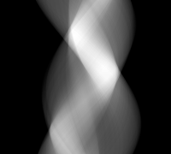
We stack up all of the projections at all angles to obtain sinogram
y
1
2
θ
2
1
3
3
x
t
This is called a ‘sinogram’, since for a given point in the object, a sinusoid is traced out as the angle is swept.

Slide 4


Forward Projection to receive sinogram
Projection
Projection
360 deg
Image
Sinogram
Rot 90°
Notes:
Forward projection to get sinogram

Slide 5
Forward Projection is Radon Transform
family of line integrals, called projections
for a fixed θ and t, we have a line along s -> ds, we sum along ds, so s drops out
P_{θ}(t) is called the Radon transform of f(x,y)

Slide 6
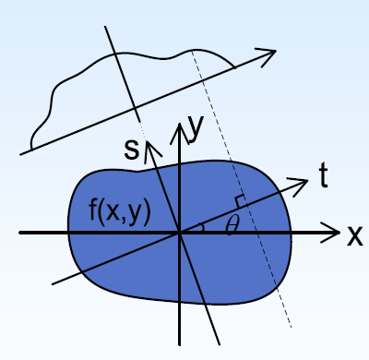
Forward projection, Line integral, and Radon transform
Forward Projection
line integral
μ₁
μ₂
adding up values in each pixel along the ray direction
μ₃
…
μ_{N}
Notes:
A projection is a line integral (or ray-sum, Radon transform) of an object. Projection data are acquired with detectors. Objects overlap on the detectors

Slide 7
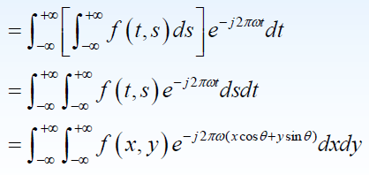
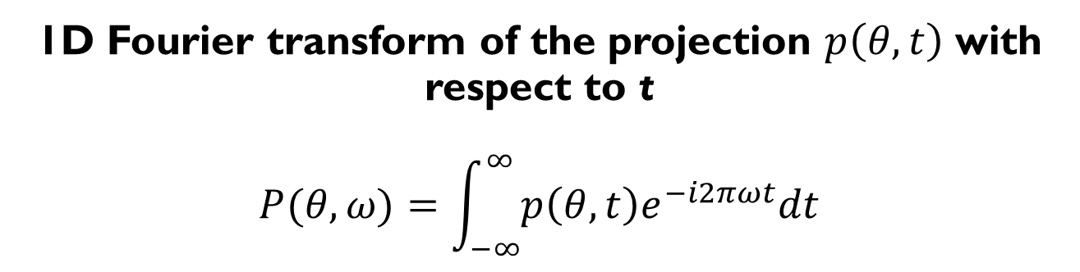
1D Fourier transform of the projection $p\left(θ,t\right)$ with respect to t $$P(θ,ω)=\int_{−∞}^{∞}{p\left(θ,t\right)e^{−i2πωt}dt}$$
The last step is due to the rotational coordinate transform between (x,y) and (s,t).

Slide 8
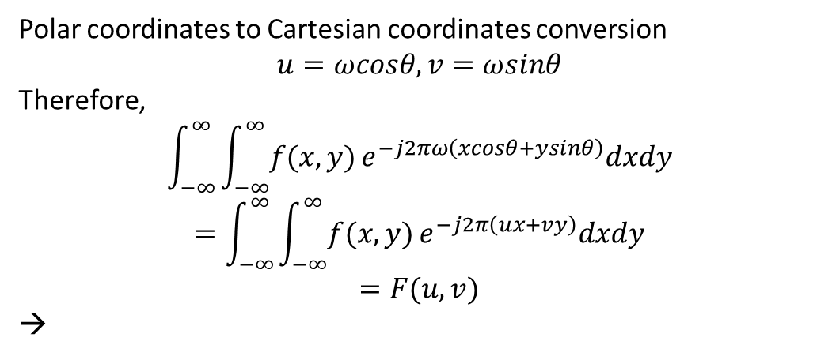
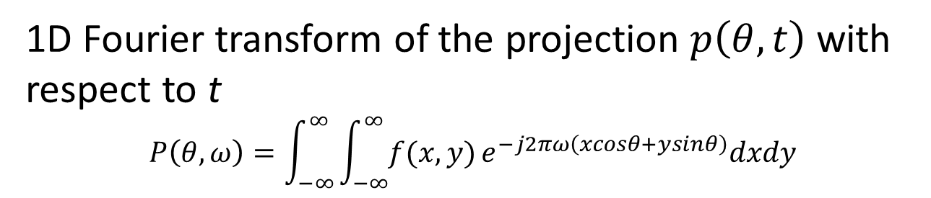

1D Fourier transform of the projection $p\left(θ,t\right)$ with respect to t $$P\left(θ,ω\right)=\int_{−∞}^{∞}{\int_{−∞}^{∞}{f(x,y)}}e^{−j2πω\left(xcosθ+ysinθ\right)}dxdy$$
Polar coordinates to Cartesian coordinates conversion
$$u=ωcosθ, v=ωsinθ$$
Therefore,
$$\int_{−∞}^{∞}{\int_{−∞}^{∞}{f(x,y)}}e^{−j2πω\left(xcosθ+ysinθ\right)}dxdy$$
$$=\int_{−∞}^{∞}{\int_{−∞}^{∞}{f(x,y)}}e^{−j2π\left(ux+vy\right)}dxdy$$
$$=F(u,v)$$
→
v
ω
θ
u
$$P\left(θ,ω\right)=F\left(u,v\right)=F(ωcosθ,ωsinθ)$$
1D Fourier transform of projection $p\left(θ,t\right)$ with respect to t is equal to 2D Fourier transform of f(x,y)!!!

Slide 9
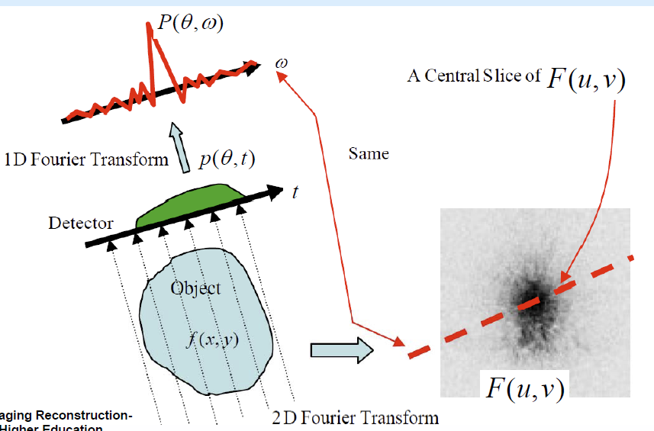
Fourier Central Slice Theorem
$$P\left(θ,ω\right)=F\left(u,v\right)=F(ωcosθ,ωsinθ)$$
G. L. Zeng, Medical Imaging Reconstruction-A conceptual tutorial; Higher Education Press, 2009.

Slide 10
Problem Statement in Image Reconstruction
Given a set of projections, P_{θ}(t), reconstruct f(x,y) to some desired degree of accuracy

Slide 11
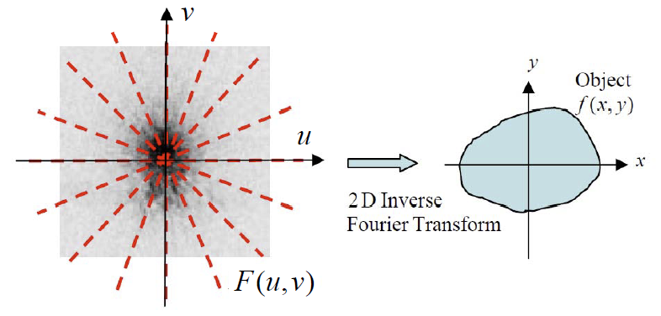

Direct Fourier Reconstruction
So, if we collect an infinite number of projections, take their 1D Fourier transforms, and cover all of (u,v) space, then the object can be reconstructed by 2D Inverse Fourier Transform.
Backprojection!
$$f(x,y)$$

Slide 12
Direct 2D Fourier Reconstruction
But we don’t use Direct 2D Fourier Reconstruction, why?

Slide 13
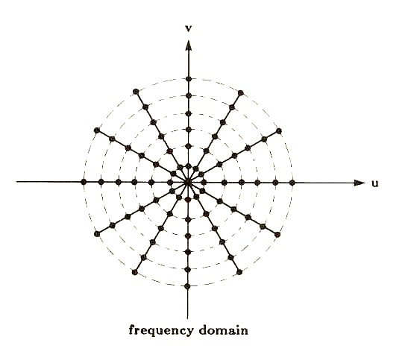
2 problems in Sampling the K space
High frequencies more sparsely sampled while low frequencies are overly sampled.
2D Interpolation from Polar coordinate to Cartesian coordinate is prone to errors.
Sampled points in the frequency domain are on Polar coordinate and not on a Cartesian coordinate.
FFT is Fast Fourier Transform, a widely used computer algorithm for numerically implementing Fourier transform.
2D inverse Fourier transform (2D iFFT) needs Cartesian coordinate and can’t use Polar coordinate. To convert the sampled point in the Polar coordinate system to Cartesian grid for the computation of iFFT, 2D interpolation (e.g. bilinear interpolation) is used .
We can’t compute anything continuously or infinitely on computer; requires numerical approximation and hence leads to errors.

Slide 14


Filtering of k space data
$$\left|ω\right|$$
$$ω$$
Demonstration of Ramp filters.

Slide 15
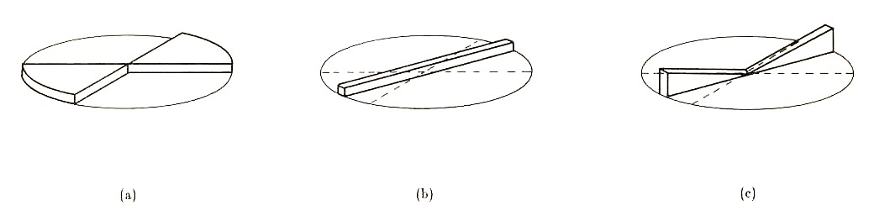
Ramped filter correction for anisotropic sampling
desired
acquired
weighted
A ramped weighting is applied to each projection’s Fourier transform to account for the variable density of sampling in k space.

Slide 16
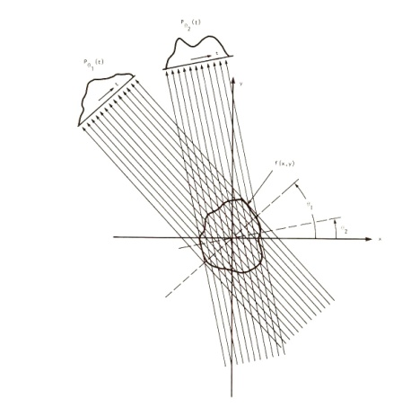
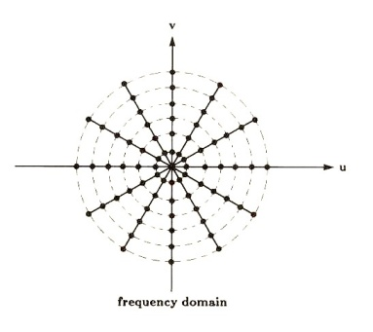
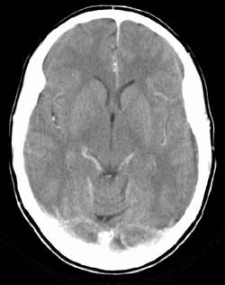
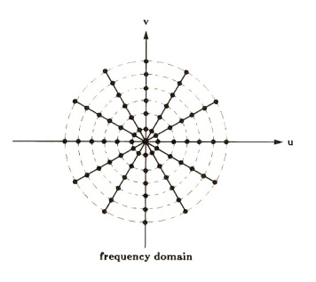
Block diagram of Direct 2DFT Recon with filter
collect all projections in (x,y)
1D FT
Radial Profiles in frequency domain (u,v)
Multiply each profile by ramp
Inverse 2D Fourier transform
Interpolate all Filtered radial profiles onto Cartesian grid
Filtered radial profiles
final image in (x,y)
v
u

Slide 17
FBP Reconstruction
Filtered back projection

Slide 18
Forward Projection
P_{θ}(t)
t
Projection
(x,y) coordinate system: object f(x,y)
(t,s) coordinate system rotated by θ
projection P collapses along s-dimension
for each θ, we have a projection, P_{θ}(t)
P_{θ}(t₁)
s
y
object f(x,y)
t
θ
x
Coordinate Rotation
t₁
The X-ray pencil beam defined as xcosθ + ysinθ = t

Slide 19
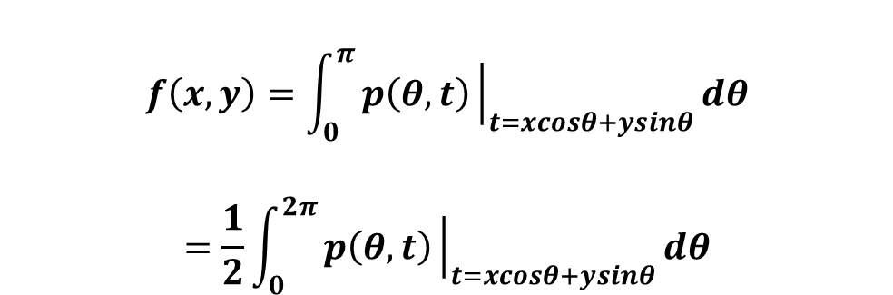
What is back projection?
Back projection paints the values back into the image matrix along the direction of measurement
Back projection
$$f\left(x,y\right)=\int_{0}^{π}{p\left(θ,t\right){\left.​\right|}_{t=xcosθ+ysinθ}dθ}$$
$$=\frac{1}{2}\int_{0}^{2π}{p\left(θ,t\right){\left.​\right|}_{t=xcosθ+ysinθ}dθ}$$
Notes:
Backprojection is a superposition procedure and it sums the data from all
projection views. Backprojection evenly distributes the projection domain
data back along the same lines from which the line-integrals were formed.
https://howradiologyworks.com/filtered-backprojection-fbp-illustrated-guide-for-radiologic-technologists/

Slide 20
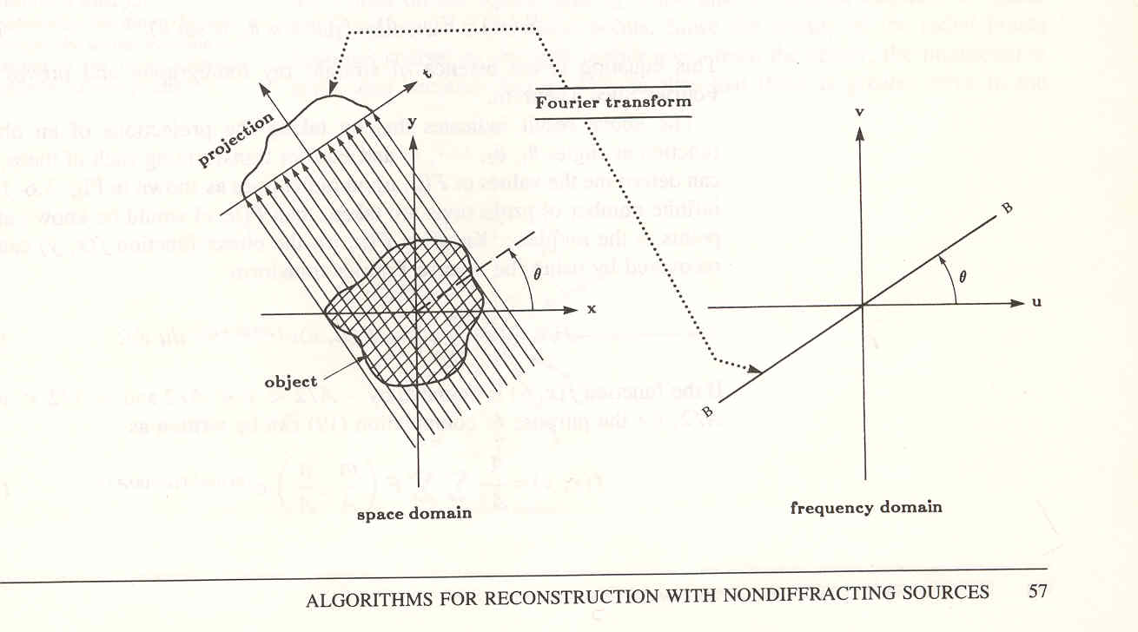
Block diagram of FBP (Filtered Back Projection) recon.
w
v
w
v
θ
θ
u
u
Radial profile in frequency domain
collect one projection
1D Fourier transform
repeat for all projections until final image obtained
Multiply by ramp
Back project across image space
Filtered radial profile
v
w
Inverse 1D Fourier transform
θ
u

Slide 21
Advantages of FBP Recon
Steps of FBP:
collect one projection
take its 1D Fourier transform
apply ramp filter
take inverse 1D Fourier transform
Back project the data across image space
repeat for all projections
Advantages of FBP:
Rather than interpolate in frequency domain, FBP allows you to:
(1). start recon after first projection is obtained;
(2). interpolation in (x,y) as part of back projection has been shown to be simpler and more accurate than the interpolation from polar grid to a Cartesian grid in spatial frequency.

Slide 22

Example: Filtering of Projections
Sinogram
Filtered Sinogram

Slide 23

Example: Filtered Backprojection
Filtered Sinogram
Reconstructed Image

Slide 24

Example: Backprojection without filter
Sinogram
Backprojected Image
Very blurry = like a low pass filter applied = high frequency info is suppressed

Slide 25
Sample iRadon Code
P = phantom(128);
R = radon(P,0:179);
I1 = iradon(R,0:179);
I2 = iradon(R,0:179,'linear','none');
subplot(1,3,1), imshow(P), title('Original')
subplot(1,3,2), imshow(I1), title('Filtered backprojection')
subplot(1,3,3), imshow(I2,[]), title('Unfiltered backprojection')

Slide 26
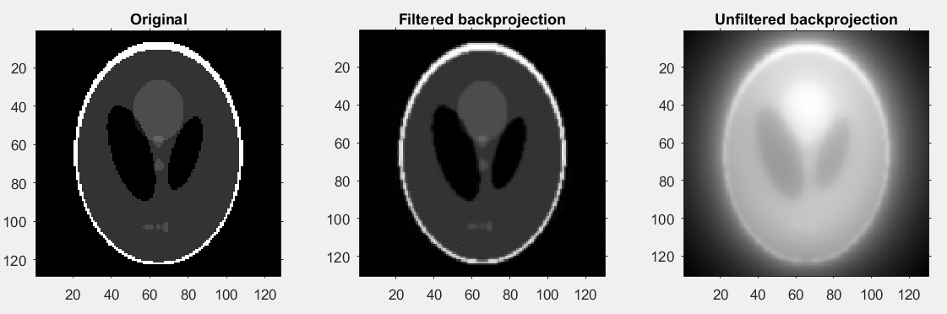
iRadon Results

Slide 27
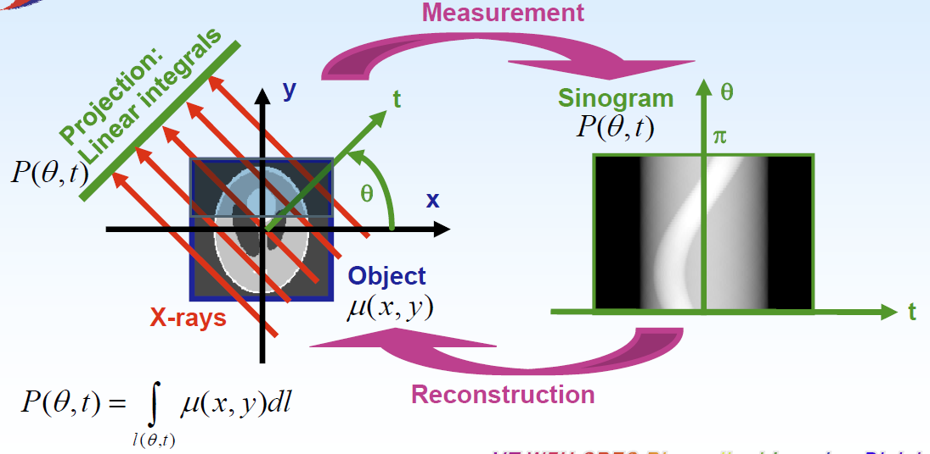
Summary: Projection & Reconstruction

Slide 28
CT Acquisition Geometry
Parallel beam
Fan beam
equiangular detectors
equally spaced detectors
¼ detector offset
Spiral CT acquisition
Cone beam
FDK algorithm

Slide 29
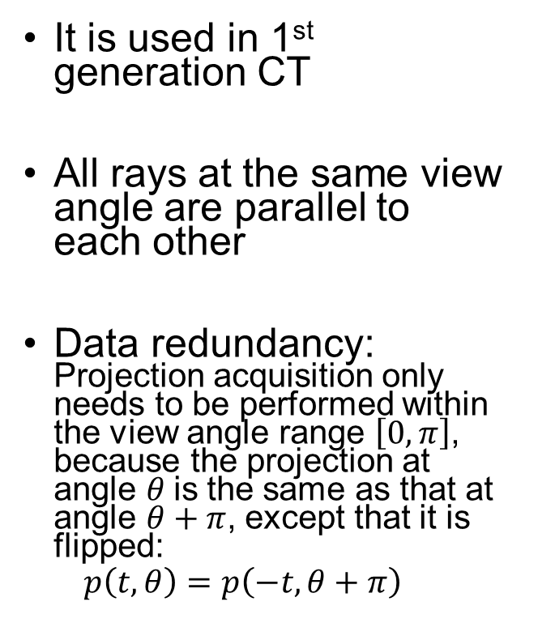
Parallel-beam CT
It is used in 1st generation CT
All rays at the same view angle are parallel to each other
Data redundancy: Projection acquisition only needs to be performed within the view angle range $\left[0,π\right]$, because the projection at angle $θ$is the same as that at angle $θ+π$, except that it is flipped:
$$p\left(t,θ\right)=p\left(−t,θ+π\right)$$
$$ξ$$
0
$$φ$$
$$ξ$$
$$φ$$
$$π$$
$$2π$$

Slide 30
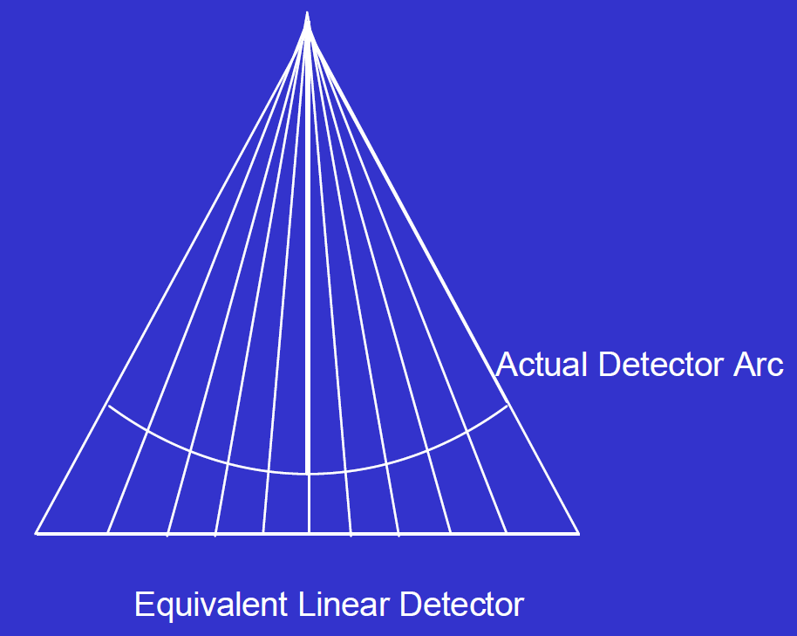
Fan beam CT
Curved detector:
equal-angular curved detector
Line detector:
equal-distant flat-detector
Notes:
The equi-spaced data collected on an arc are the same as non-linearly –space data collected along a linear detector. We therefore multiply the projection data elements with a 1/cosine weighting factor to reflect this fact.

Slide 31
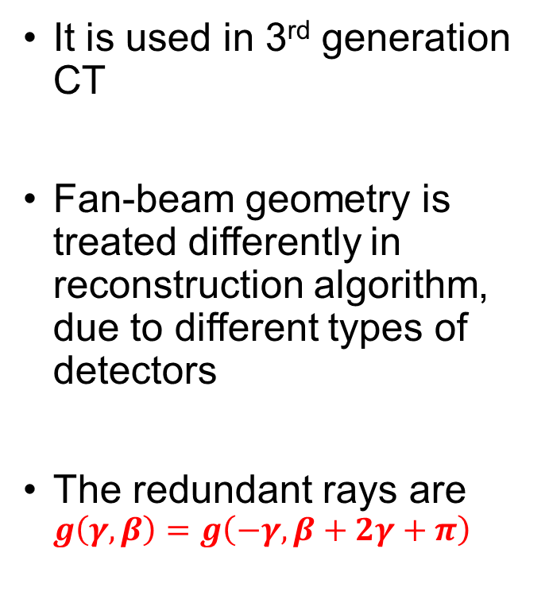
Fan-beam CT geometry
It is used in 3rd generation CT
Fan-beam geometry is treated differently in reconstruction algorithm, due to different types of detectors
The redundant rays are $g\left(γ,β\right)=g\left(−γ,β+2γ+π\right)$
$$γ$$ | Angle between an edge ray and the central ray. 2$γ$ is the fan angle.
$$β$$ | View angle: the angle between central ray and y-axis (the view angle)
$$g\left(γ,β\right)$$ | Fan-beam projection

Slide 32
Half Scan, Short Scan, Full Scan
Scan Angle – the coverage angle of the source orbit during scanning.
Scan Angle | Mode
180 deg | Half scan
180 deg + fan angle | Short scan
360 | Full scan
What if scan angle < 180 deg? →
limited-angle tomography, or tomosynthesis

Slide 33
Fan Beam CT Reconstruction
inverse quadratic weighting in backprojection to compensate for decreased ray-spacing towards source
Adapt the parallel-beam back-projection formula to account for diverging fan-beam.

Slide 34
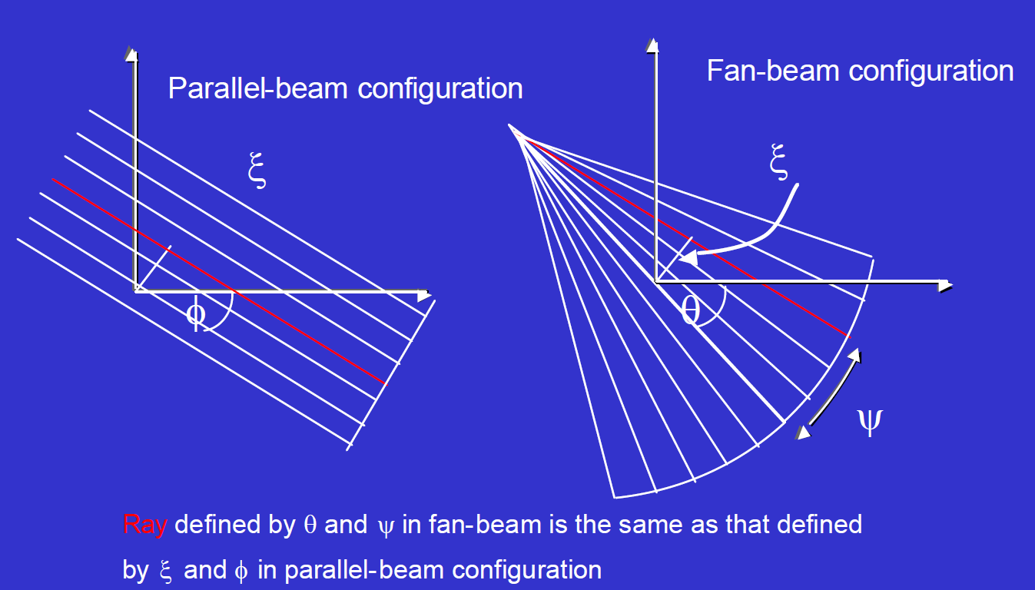
Fan Beam CT Reconstruction
2. Rebinning is another technique, in which the fanbeam data is interpolated into the corresponding parallel-beam data.

Slide 35
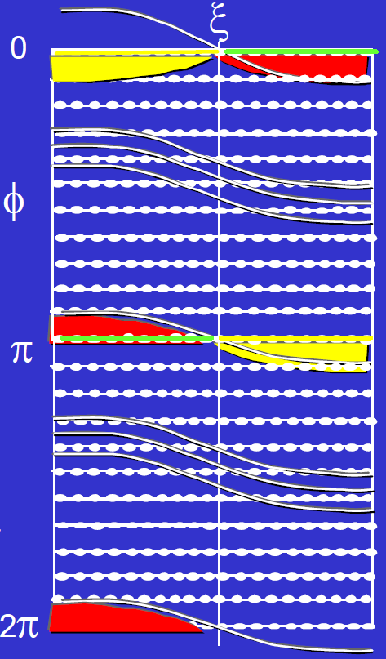
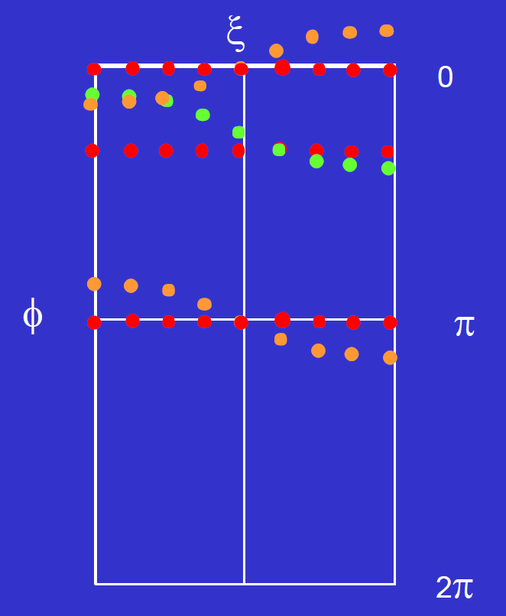
Fan-beam vs. parallel-beam sinogram
Interpolating fan-data into parallel-beam sinogram
The data from the fan-beam sinogram at 180 deg “wraps-around” into the sinogram at the top (orange color).
Note that sinogram line for φ= 0 and φ = π are equivalent but reversed in ξ.
Rotating fan-beam detector by π misses red areas in sinogram.
Need to rotate extra Ψ (fan angle) to collect sufficient data.

Slide 36
Spiral/Helical Scanning
Simultaneous
Source rotation
Table translation
Data acquisition
The source is just rotating around circle, it is the table motion that induces the spiral trajectory of acquisition.

Slide 37
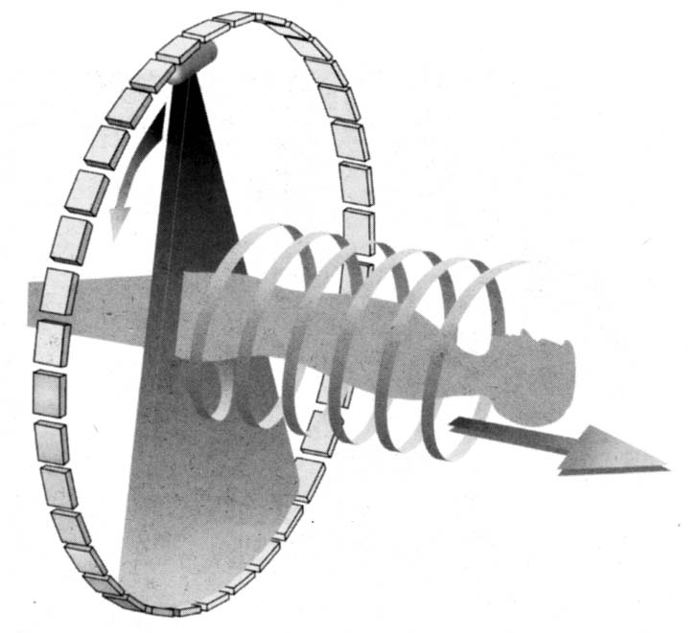
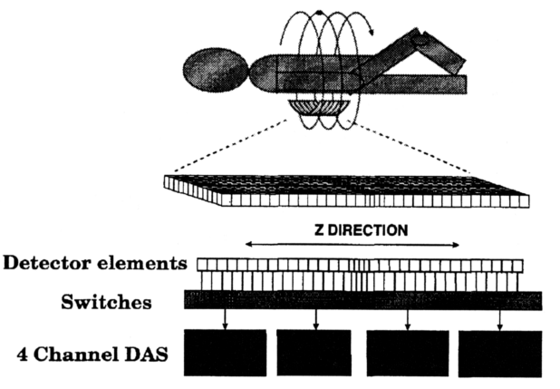
Spiral CT
Single-slice
Multi-slice

Slide 38
Pitch in Spiral/Helical CT
Pitch
p = $\frac{d}{S}$
d – table feed (in mm) per rotation of the x-ray tube
S – slice thickness (in mm)
Therefore, pitch is dimensionless.
Notes:
Higher pitch means thinner slice.

Slide 39
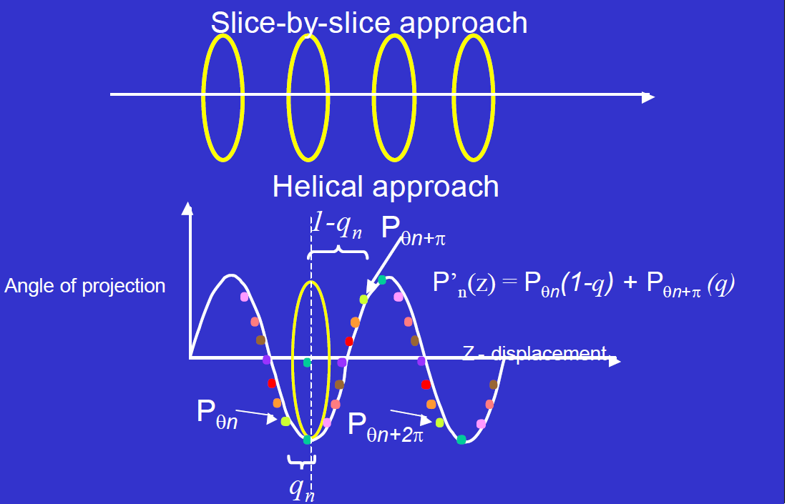
Z interpolation in spiral CT
Sinogram repeat every 180 degree
Notes:
The simplest approach to derive an interpolated projection for angle q for example, is to locate the projections for this angle on each side of the desired slice and compute a synthesized projection by linear interpolation.

Slide 40
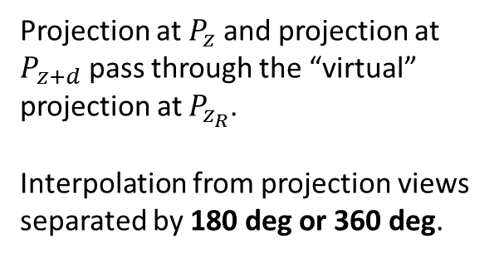
Z interpolation in spiral CT
Projection at $P_{z}$ and projection at $P_{z+d}$ pass through the “virtual” projection at $P_{z_{R}}$.
Interpolation from projection views separated by 180 deg or 360 deg.
Detector Trace
A selected planar slice
Projection angles
$$P_{z_{R}}=\left(1−w\right)P_{z}+wP_{z+d}$$
$$w=\frac{z_{R}−z}{d}$$
d
z
$$z_{R}$$
z+d
z displacement

Slide 41
Cone-Beam CT (CBCT) Geometry
This geometry looks like a pyramid, but that is just because the detector array is square.

Slide 42
Cone-beam CT Reconstruction
No exact reconstruction for circular cone-beam geometry
Approximate procedures proposed by Feldcamp, Wang
Perform data weightings similar to fan-beam back-projection
Back-project into 3D volume
Reconstructions acceptable if cone-angle not too large

Slide 43
Rebinning for each row
The rebinning process is carried out on a row-by-row basis in exactly the same manner as if it were a fan-beam dataset.
After rebinning, each projection becomes a set of tilted parallel beams with different tilting angles for different detector rows.

Slide 44


FDK (Feldkamp, Davis and Kress) Formula
D – source-object distance (SOD)
D+y’ – source-detector distance (SDD)
2γ - fan angle
2τ - cone angle
z, z’ – rotation axis
(x’, y’, z’) – rotational coordinate system, with detector parallel to x’
(s, v) – imaginary detector

